Slide 1

Angular JS Template and Controller s

Slide 2
Agenda
Getting started
Controllers
Interaction

Slide 3


Slide 4
Introduction to SPA
What is Single Page Application (SPA),
Difference between AngularJS and Angular

Slide 5
What is Angular?
Angular (formerly called Angular JS) is a typescript based web application framework that supports full-stack development for building all types of web applications.
It helps in creating reactive single page application (SPA) and is completely based on the concept of components.
Angular is owned by Google, and its stable version was released on September 14, 2016. Angular's official website is https://angular.io/.
Google makes sure that they release a major version of Angular every 6 months.

Slide 6

Single-page applications are web applications or a special type of website that provide users with a very intuitive, responsive, and fast user experience.
It is enriched with menus, multiple blocks, tiles, and interactive buttons on one page, helping users easily navigate the application.
This helps to dynamically load a portion of the current page instead of reloading the entire page from the server.
This is why angular based applications are called reactive fast speed loading pages.

Slide 7
Advantage of AngularJS
Dependency Injection: Dependency Injection specifies a design pattern in which components are given their dependencies instead of hard coding them within the component.
Two way data binding: AngularJS creates a two way data-binding between the select element and the orderProp model. orderProp is then used as the input for the orderBy filter.
Testing: Angular JS is designed in a way that we can test right from the start. So, it is very easy to test any of its components through unit testing and end-to-end testing.
Model View Controller: In Angular JS, it is very easy to develop application in a clean MVC way. You just have to split your application code into MVC components i.e. Model, View and the Controller.
Directives, filters, modules, routes etc.

Slide 8
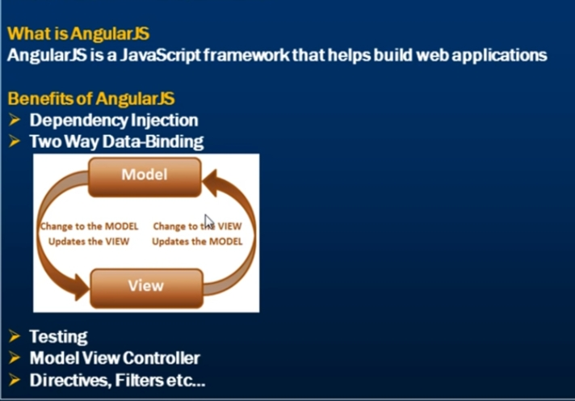

Slide 9
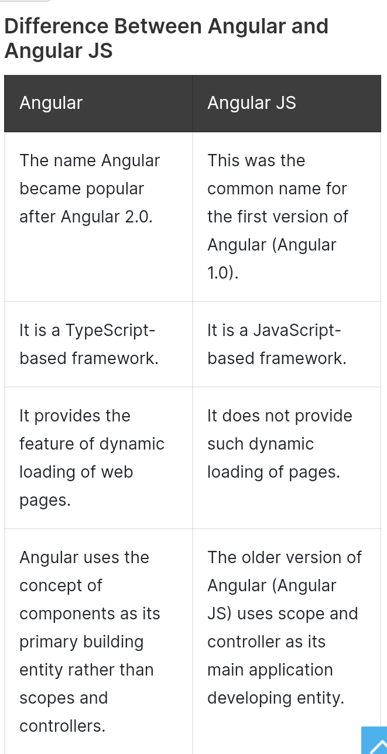

Slide 10
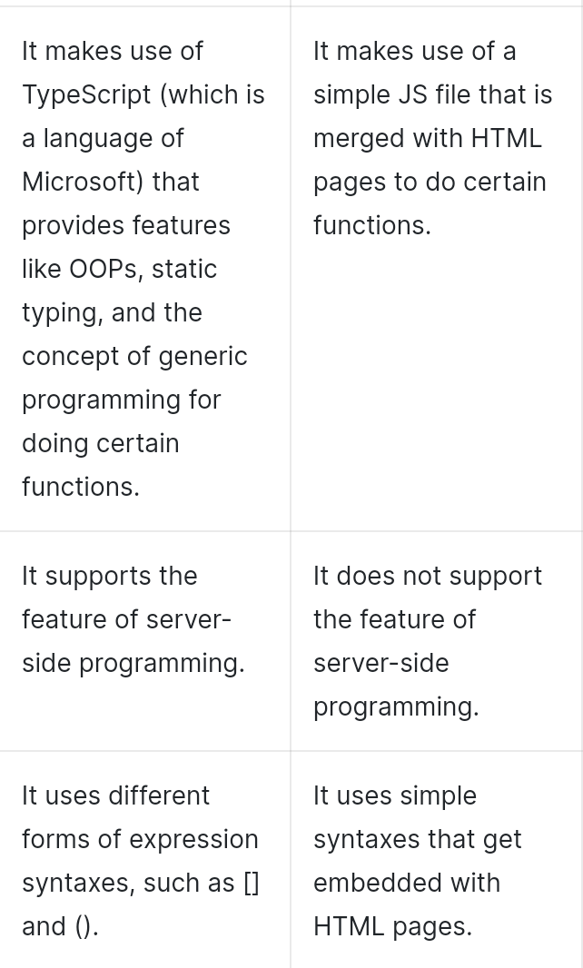

Slide 11
INSTALLATION PROCESS

Slide 12
STEP 1: Install VS CODE
https://code.visualstudio.com/download
STEP 2: Install Node and NPM
https://nodejs.org/en/
check environmental variable
After install nodejs
Go to vb terminal-> new terminal npm install -g @angular/cli@latest
create project
ng new firstApp
(optional)(if error follow https://www.c-sharpcorner.com/article/how-to-fix-ps1-can-not-be-loaded-because-running-scripts-is-disabled-on-this-sys/)
compile file: ng serve
STEP 3: Install Angular CLI
STEP 4:Create First Angular App

Slide 13
Angular CLI
CLI overview,
Commands overview,
Creating a project,
Running a project,
ng add, ng build, ng config, ng new, ng run

Slide 14
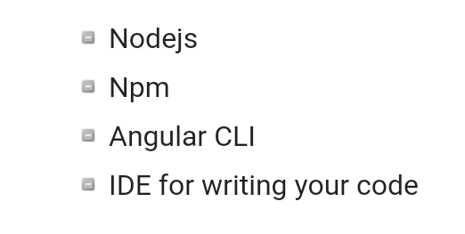
To install Angular 7, we require the following −

Slide 15
Install Visual Studio Code IDE or JetBrains WebStorm or Eclipse IDE
You must have an IDE like Visual Studio Code IDE or JetBrains WebStorm to run your Angular 7 app.
VS Code is light and easy to setup, it has a great range of built-in code editing, formatting, and refactoring features. It is free to use.
It also provides a huge number of extensions that will significantly increase your productivity

Slide 16
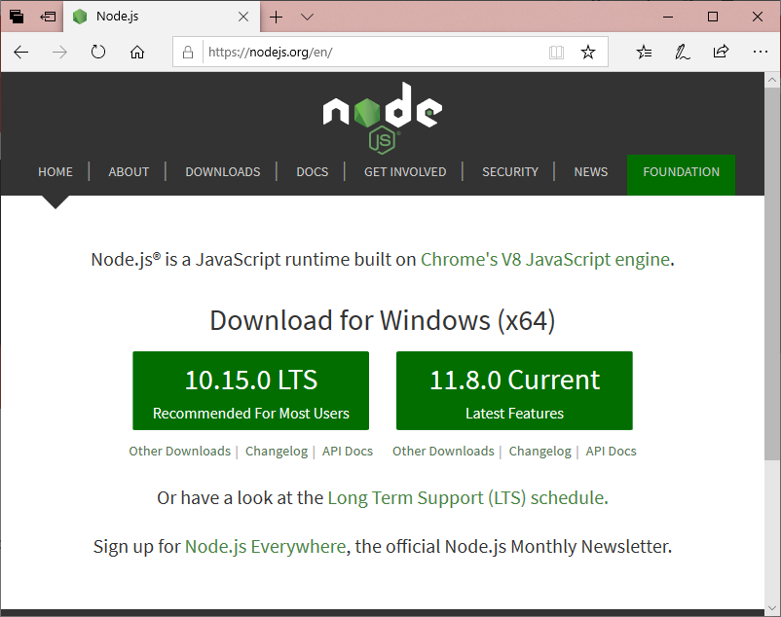
Install Node.js
You should install node.js to run your Angular 7 app. It manages npm dependencies support some browsers when loading particular pages.
It provides required libraries to run Angular project. Node.js serves your run-time environment as your localhost.

Slide 17

Use npm to install Angular CLI
The Angular CLI (command-line interface) is a great tool to efficiently build Angular application by automating operations in Angular projects rather than manually.
Run the Angular CLI command to install Angular CLI

Slide 18
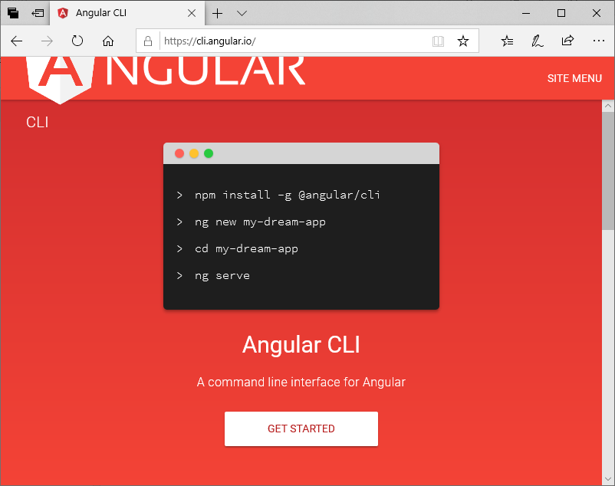

Slide 19
Angular File Structure
Angular Structure,
App Module,
Core Module,
Shared Module,
Feature Modules,
Styles,
Assets

Slide 20
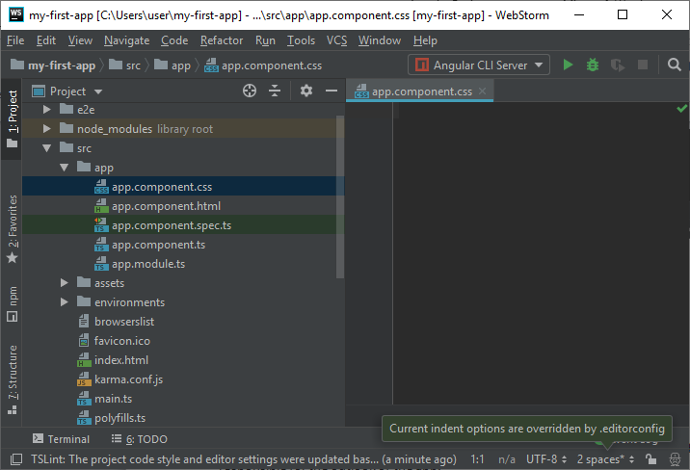

Slide 21
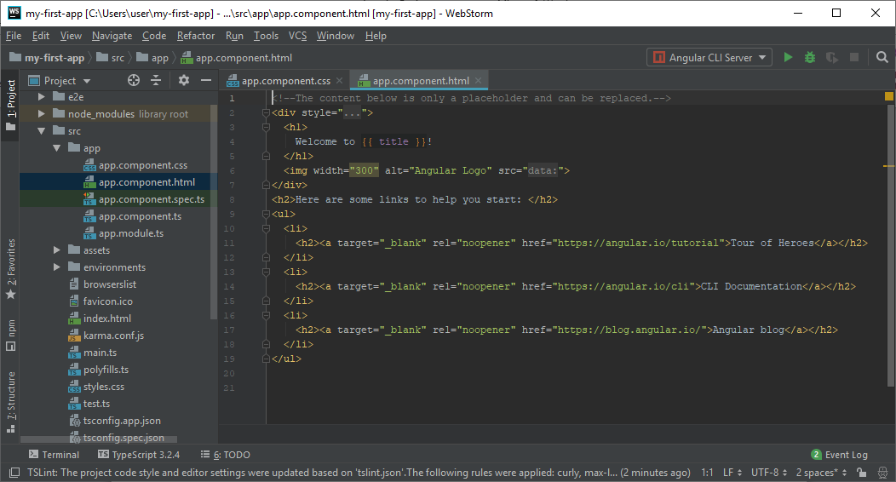

Slide 22
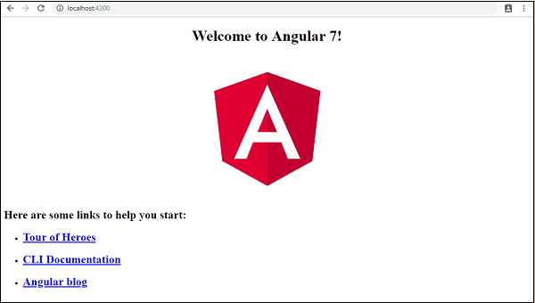

Slide 23
TypeScript
TypeScript vs JavaScript,
Transpilation,
tsconfig.json,
typings

Slide 24
What is JavaScript?
JavaScript is a scripting language which helps you create interactive web pages.
It followed rules of client-side programming, so it runs in the user's web browser without the need of any resources forms the web server.
You can also use Javascript with other technologies like REST APIs, XML, and more.

Slide 25
What is Typescript?
Typescript is a modern age Javascript development language.
It is a statically compiled language to write clear and simple Javascript code.
It can be run on Node js or any browser which supports ECMAScript 3 or newer versions.

Slide 26
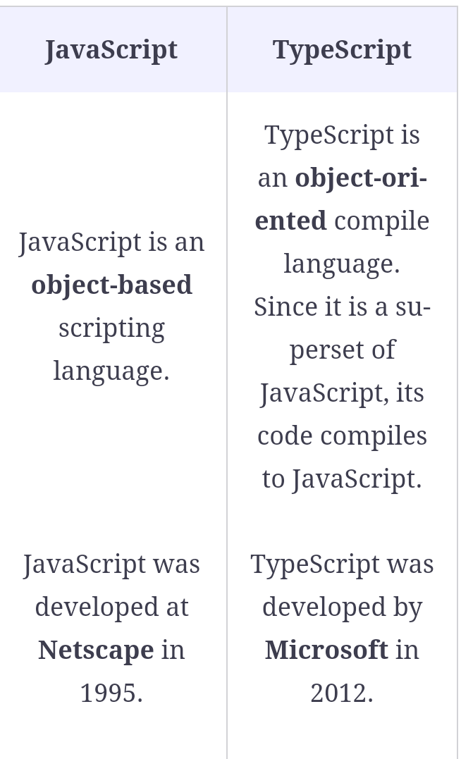

Slide 27
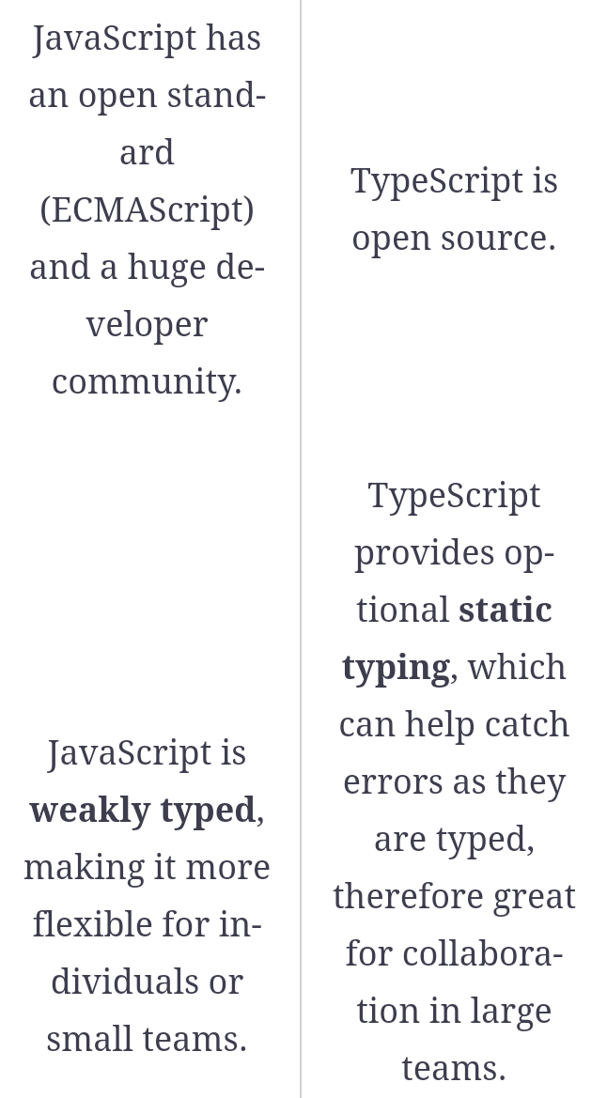

Slide 28
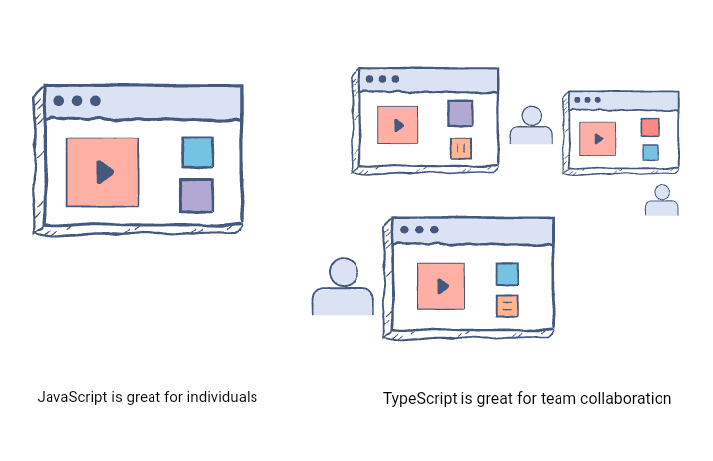

Slide 29
Advantages of using TypeScript over JavaScript
TypeScript can point out compilation errors at the time of development, which JavaScript can not do because it is an interpreted language
TypeScript, as mentioned above, offers static typing which allows catching type errors at compile time and therefore gives a less painful development experience
Perhaps the biggest feature that TypeScript provides over JavaScript is Type-Checking, which can prevent bugs

Slide 30
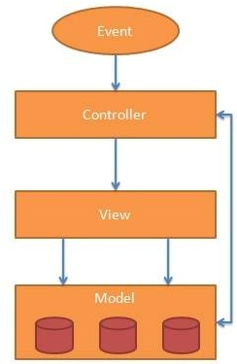
AngularJS MVC Architecture

Slide 31
The MVC pattern is made up of the following three parts:
Model: It is responsible for managing application data. It responds to the requests from view and to the instructions from controller to update itself.
View: It is responsible for displaying all data or only a portion of data to the users. It also specifies the data in a particular format triggered by the controller's decision to present the data. They are script-based template systems such as JSP, ASP, PHP and very easy to integrate with AJAX technology.
Controller: It is responsible to control the relation between models and views. It responds to user input and performs interactions on the data model objects. The controller receives input, validates it, and then performs business operations that modify the state of the data model.

Slide 32


Slide 33
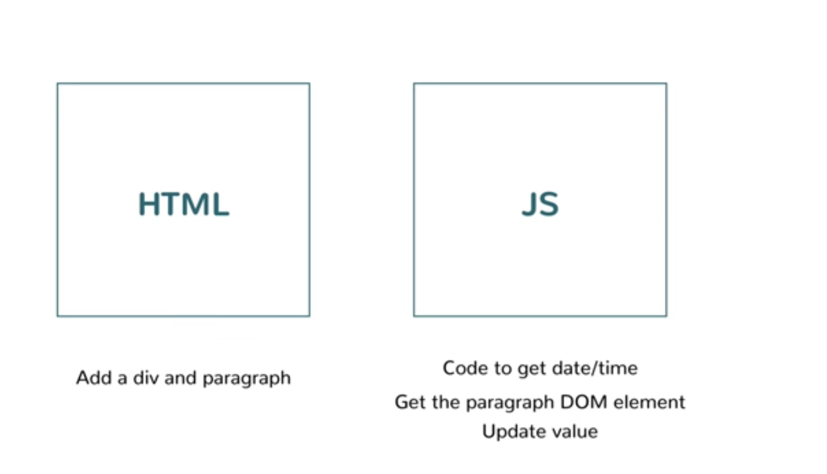

Slide 34
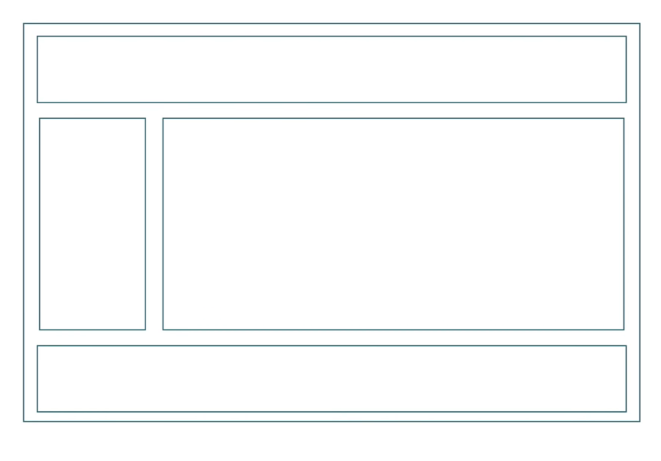

Slide 35
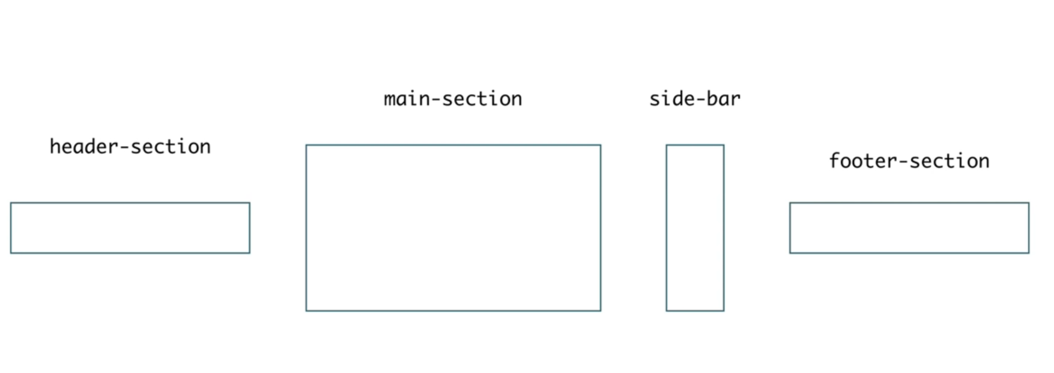
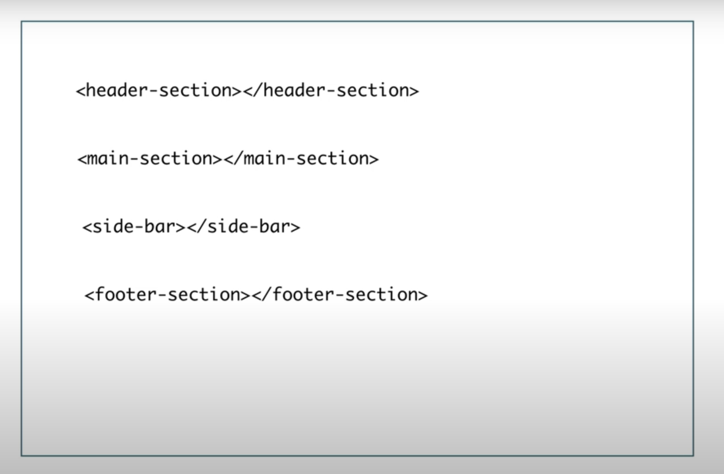

Slide 36
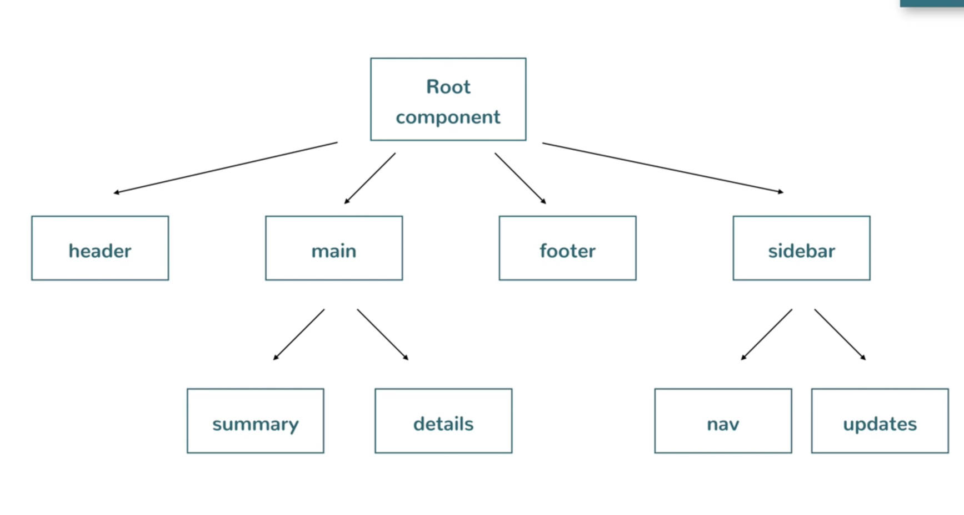

Slide 37


Slide 38
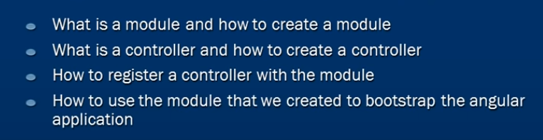

Slide 39
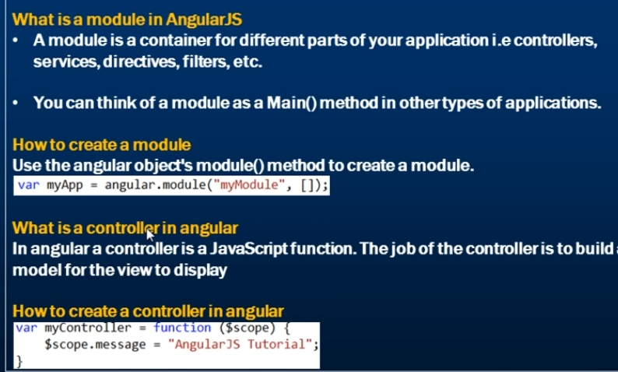

Slide 40
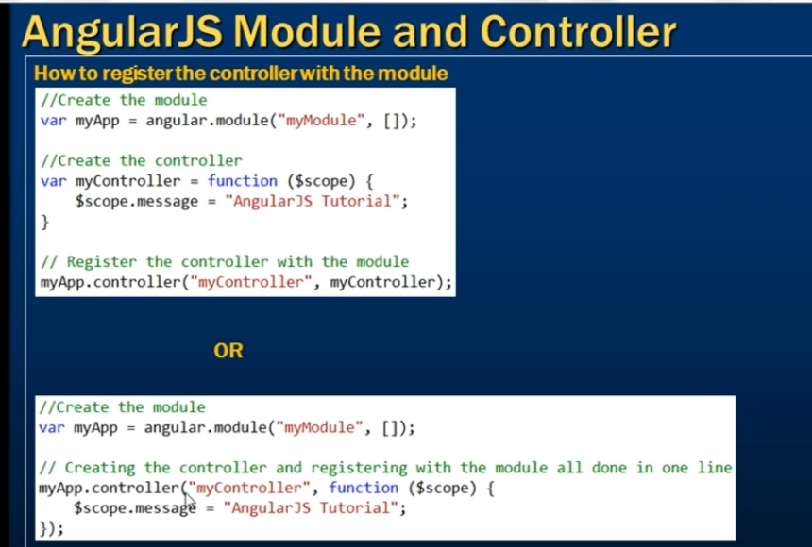

Slide 41
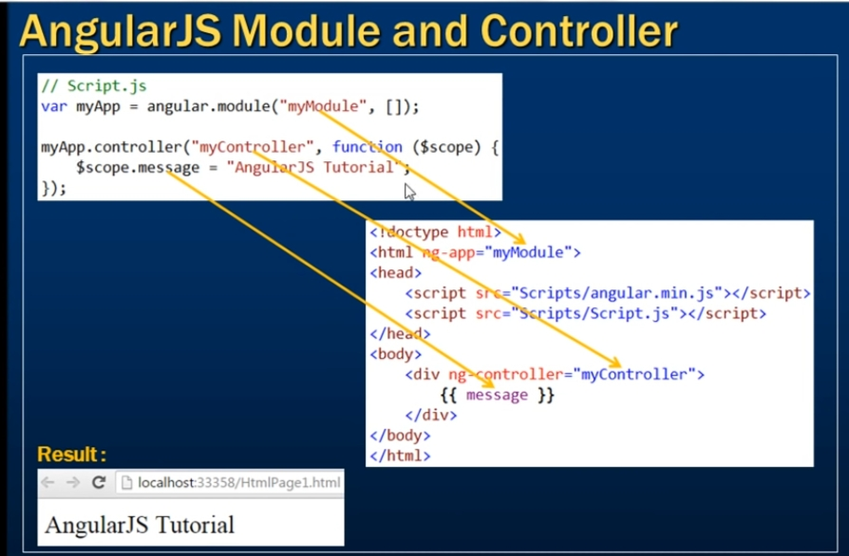

Slide 42


Slide 43
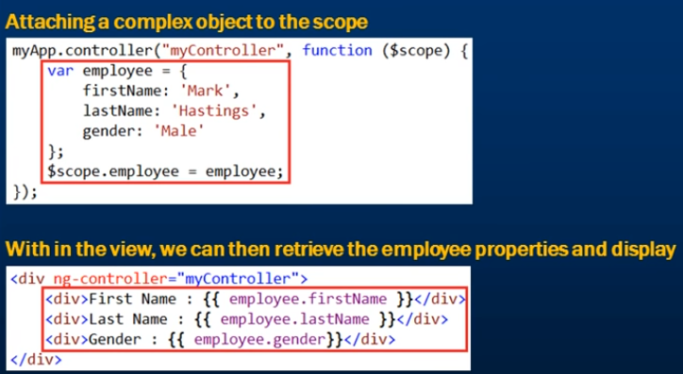

Slide 44
